Slide 1
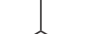
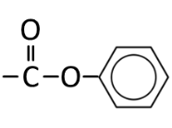
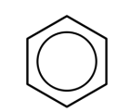
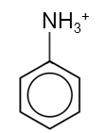


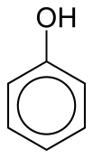






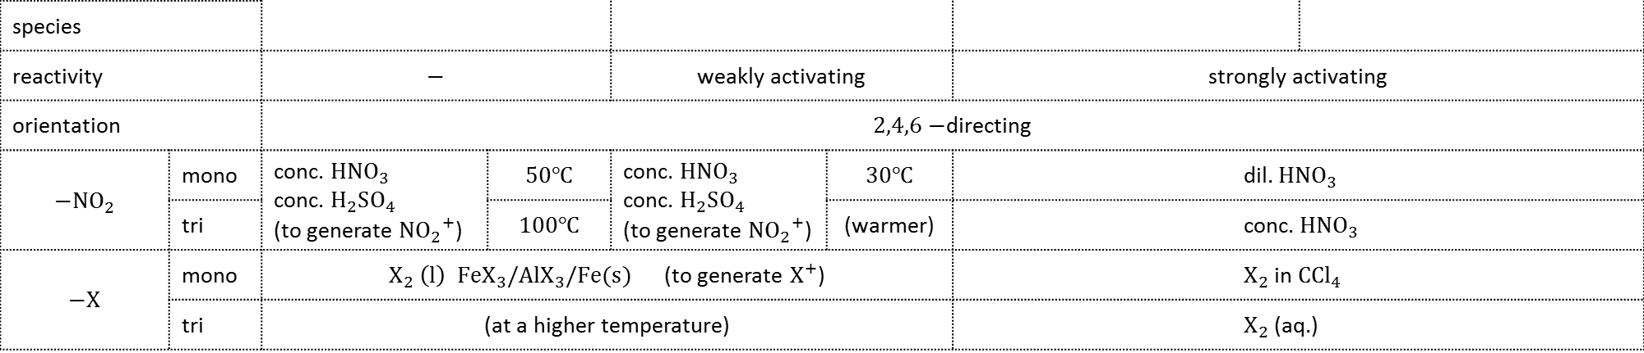
NO₂
$Sn$ conc. $HCl$ reflux
$RCOCl$ r.t.p. [condensation]
COOH
PHENYLAMMONIUM
PHENOXIDE
NITROBENZENE
strong
ESTER
BENZONIC ACID
violet complex
$$FeCl_{3}$$
conc.$HNO_{3}$ conc. $H_{2}{SO}_{4}$ 50°C [(${NO_{2}}^{+}$)]
NH₂
electrophilic substitution
$CH_{3}Cl, AlCl_{3}$ [(${CH_{3}}^{+}$)]
$Na$(s)
species
reactivity |  | $$−$$ |  | weakly activating |  | strongly activating
orientation |  | $2,4,6−$directing
$$−NO_{2}$$ | mono | conc. $HNO_{3}$ conc. $H_{2}SO_{4}$ (to generate ${NO_{2}}^{+}$) | $$50℃$$ | conc. $HNO_{3}$ conc. $H_{2}SO_{4}$ (to generate ${NO_{2}}^{+}$) | $$30℃$$ | dil. $HNO_{3}$
 | tri |  | $$100℃$$ |  | (warmer) | conc. $HNO_{3}$
$$−X$$ | mono | $X_{2} \left(l\right) FeX_{3}/AlX_{3}/Fe(s)$ (to generate $X^{+}$) |  |  |  | $X_{2}$ in$C{Cl}_{4}$
 | tri | (at a higher temperature) |  |  |  | $X_{2}$ (aq.)
BENZENE
METHYLBENZE
PHENYLAMINE
PHENOL
reactants, catalysts and condition [(nucleophile/electrophile)]

